Slide 1

Welcome to GEOG 463/563!
Analytical Workflows for Earth Systems Science

Slide 2
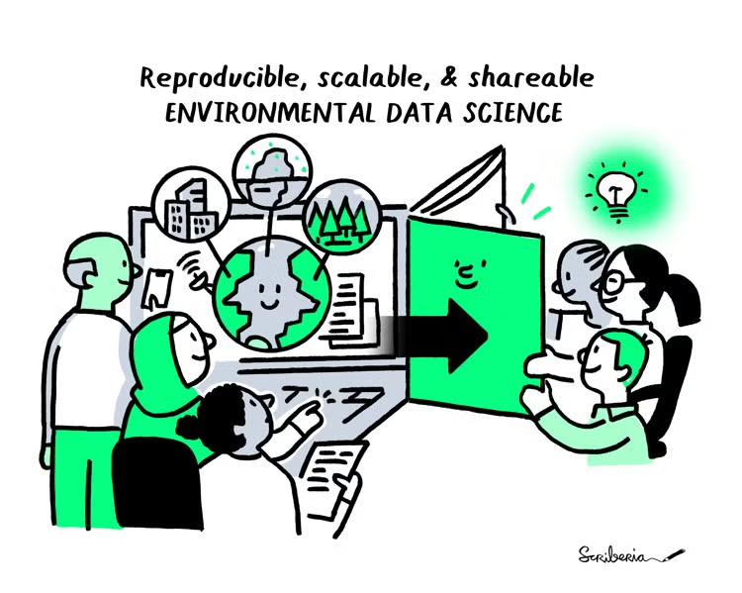
Daily Agenda
Instructor and class introductions (10 min)
Course overview and motivation (30 min)
Reading and discussion (40 min)

Slide 3




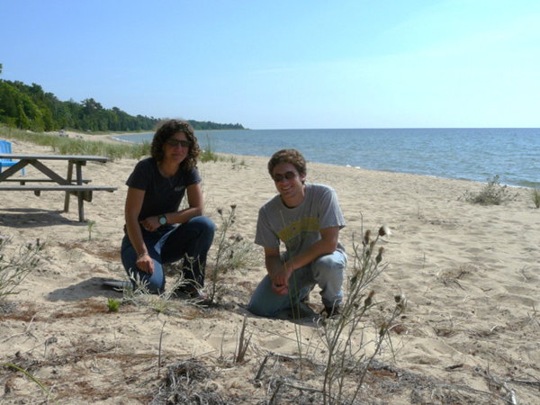


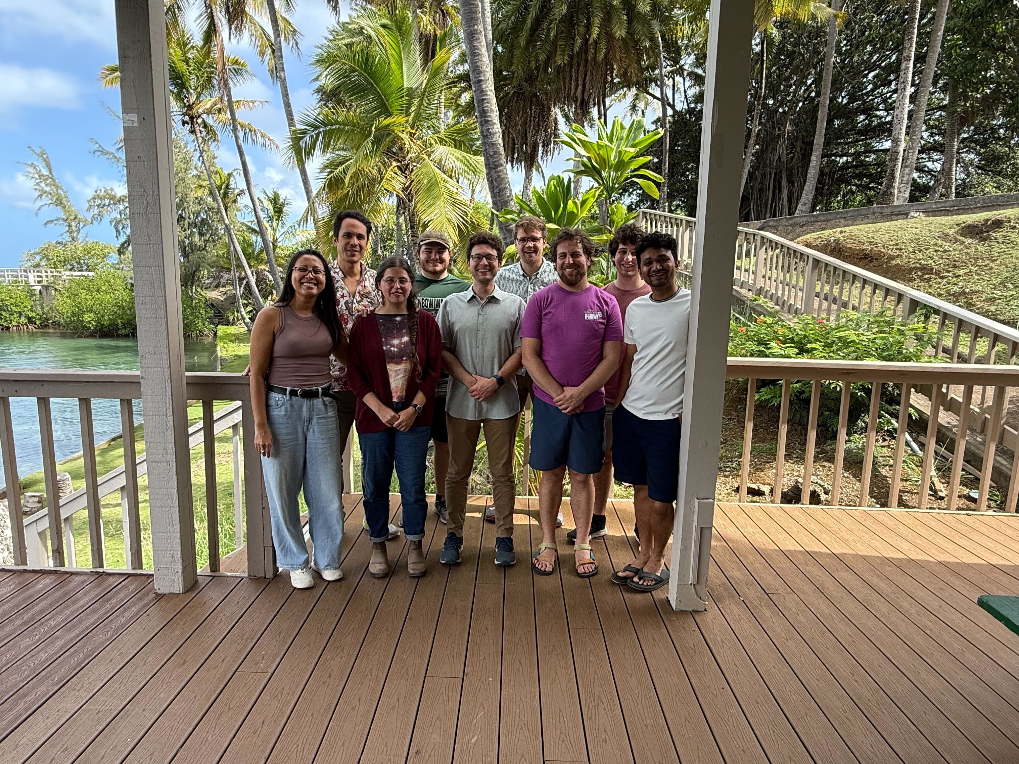







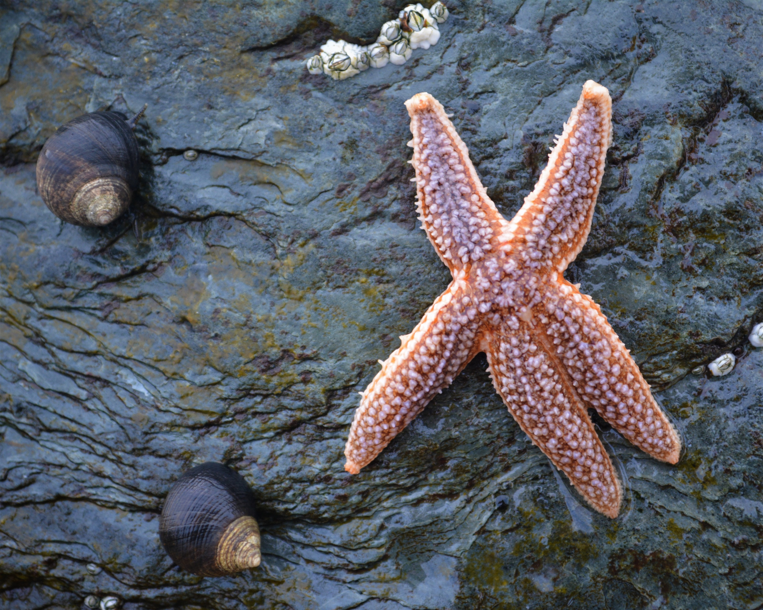
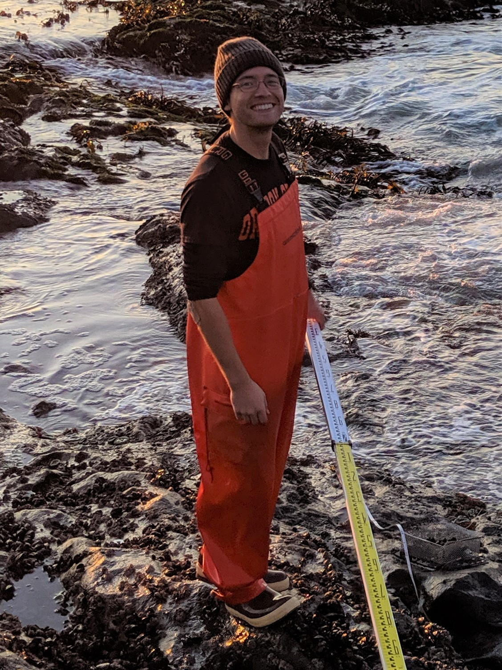

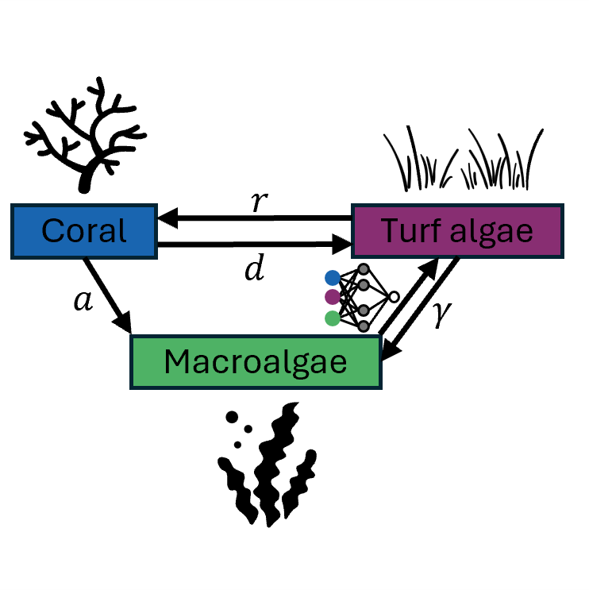








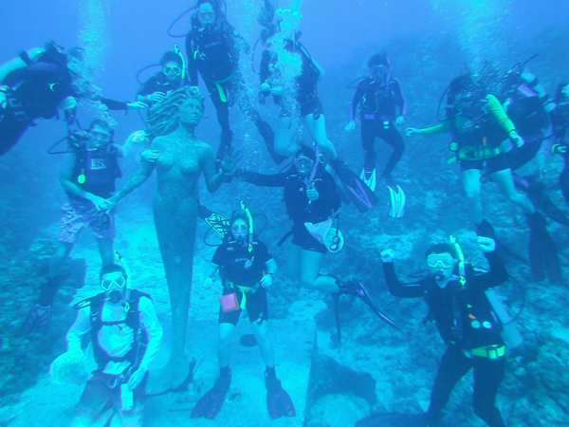




2011–2015
2015–2017
2017–2023
2023–2025
BA in Biology & Environmental Studies
Technical Services Analyst for Radiology Information System
PhD in Integrative Biology, PhD minor in Statistics
Postdoctoral Research Associate & Instructor

Slide 4
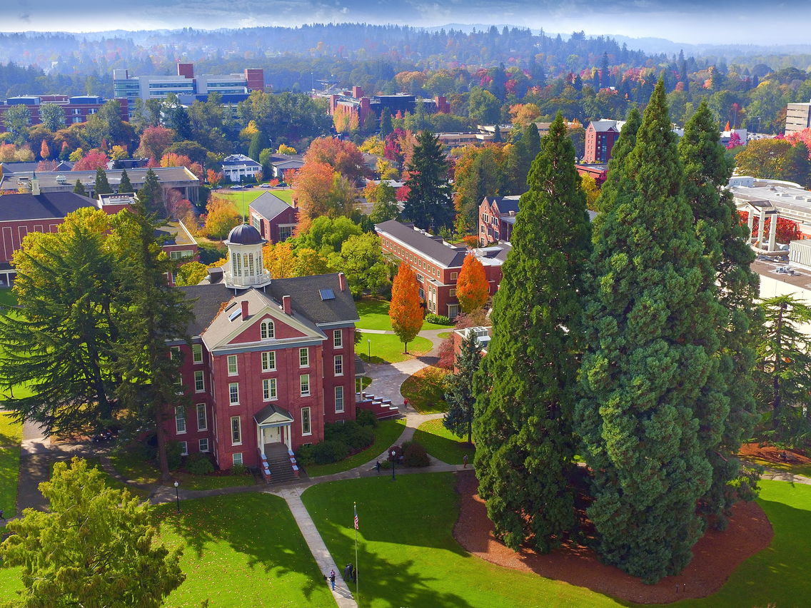

Starting Fall 2025
Assistant Professor of Data Science,
School of Computing & Information Sciences
Please give me feedback!

Slide 5
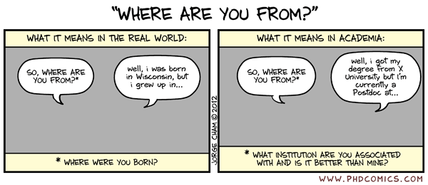
Introductions
Preferred name
Pronouns
Year in school
Major
What did you do over spring break?
What do you hope to gain from this course?

Slide 6
Course Description
Explores data science methods used to gather, validate, organize, analyze, and summarize large amounts of environmental and ecological information.
Focuses on developing analytical workflows that are efficient, reproducible, and modular using tools such as the R coding language, RStudio, GitHub, and JupyterLab.
Examines case studies including climate change, biodiversity assessments, epidemic modeling, marine spatial planning, and natural resource management.

Slide 7
Learning Outcomes
Upon completion of this course, all students will be able to:
Design and conduct a research project involving the analysis of big environmental data
Apply best practices in data collection, cleaning, wrangling, analysis, and visualization
Read and write R code using several packages
Implement best practices in scientific programming to promote reproducible research
Manage complex research projects using a version control system
In addition to the above, graduate students will be able to:
Locate and cite relevant primary literature
Synthesize their findings within the broader environmental or scientific context

Slide 8
Research Project
The objective of the collaborative, term-long research project is to engage students in a detailed exploration of environmental data, emphasizing data acquisition, analysis, and the formulation of actionable recommendations for stakeholders. Groups of two to three students will identify publicly available datasets related to chosen environmental topics, conduct mathematical and statistical analyses, and present their findings in an oral presentation and white paper. Group members will collaborate to write a white paper as a persuasive, authoritative, in-depth report that presents a problem and provides a solution. Students will also write peer reviews and revise their work based on reviews.

Slide 9
Graduate-level Expectations
One of the core skills that graduate students should develop is finding, reading, and citing literature. As part of their lab summary assignments, students registered in GEOG 563 must write additional Discussion and References sections in their R Notebooks. The Discussion should place their findings or datasets in a broader environmental or scientific context, be between 500-750 words (not including citations), and reference at least 8 primary or secondary research articles. In addition, students enrolled in GEOG 563 are expected to present work that is significantly more rigorous in both depth of study and methodology than students enrolled in GEOG 463.

Slide 10
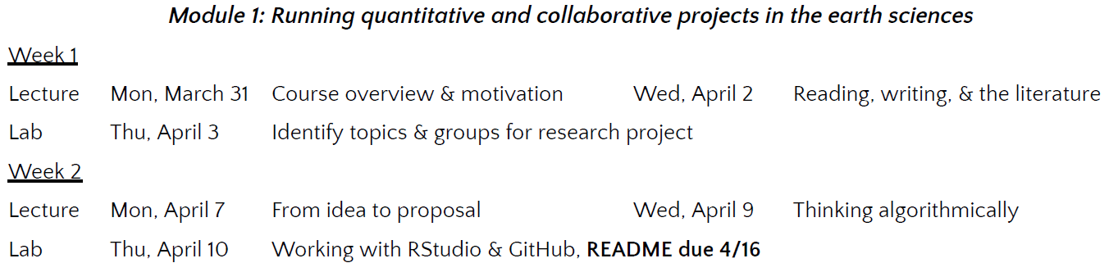
Course Schedule – Module 1
Zech lead, James support
James lead, Zech support

Slide 11
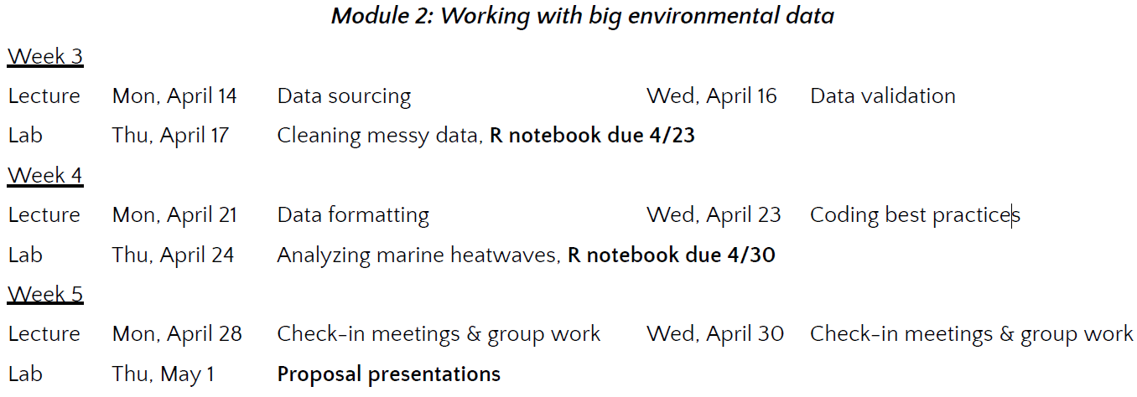
Course Schedule – Module 2
Zech lead, James support
Zech lead, James support
James lead, Zech support

Slide 12
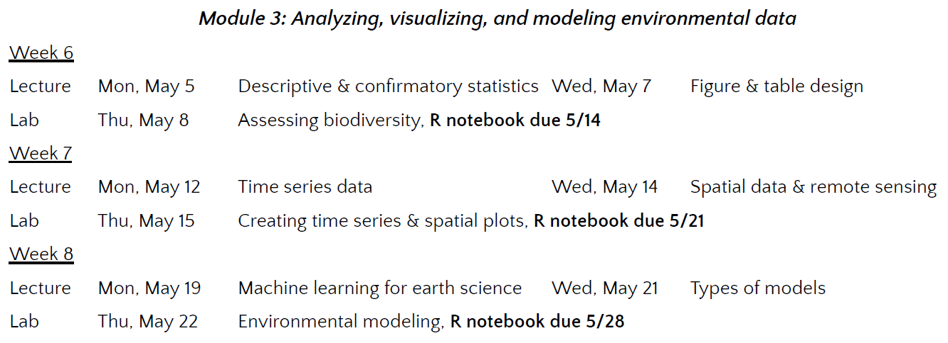
Course Schedule – Module 3
Zech lead, James support
James lead, Zech support
Jack lead, Zech James support

Slide 13
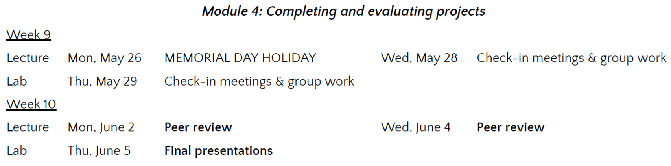
Course Schedule – Module 4
James lead, Zech support
Zech lead, James support

Slide 14
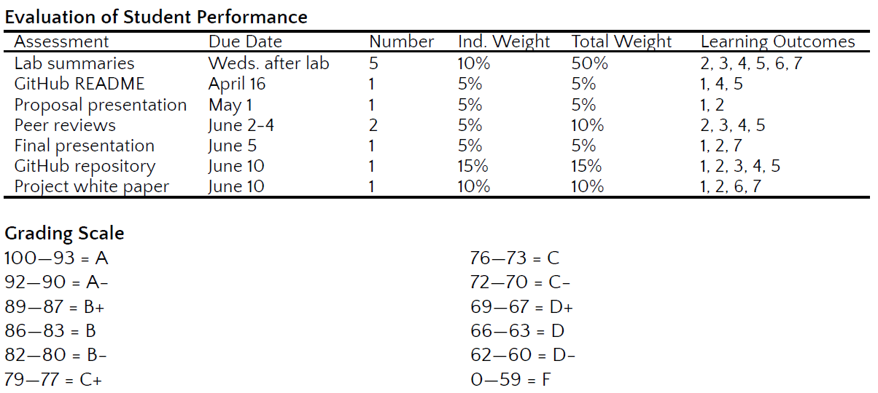
Assessments and Grades

Slide 15
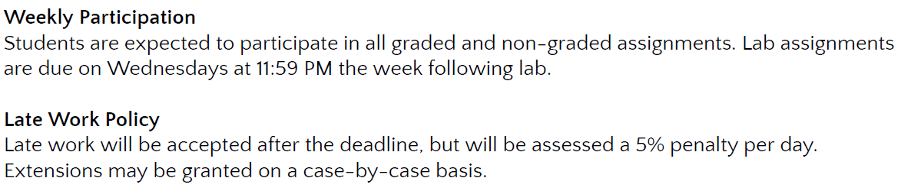
Assessments and Grades

Slide 16
Canvas Tour
https://canvas.oregonstate.edu/courses/2012319

Slide 17
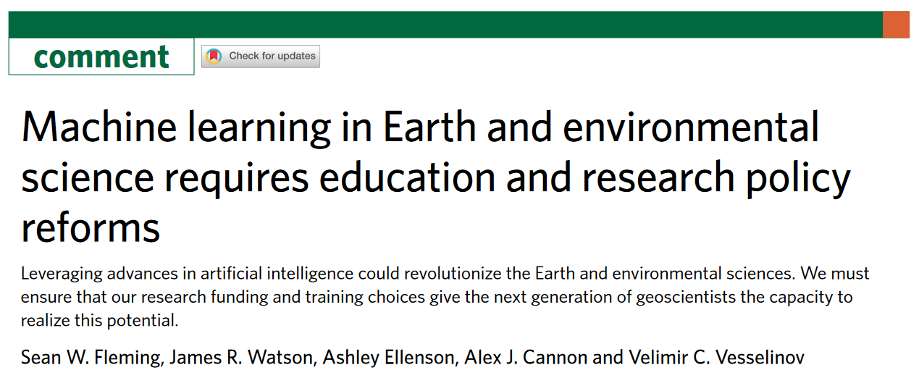
Reading (20 minutes)

Slide 18
Discussion (20 minutes)
Why is adopting artificial intelligence (AI) crucial for Earth and environmental science education and research?
What are some of the barriers facing AI adoption?
What policies can be enacted to address those barriers?
What did you learn from the “Data Science 101” table?
How should we work with AI tools (e.g., ChatGPT, coding packages) in an ethical way during this course?

Slide 19
Week 1 To-Dos
Create a GitHub account on Thursday, April 3 (in-lab)
Join the course GitHub repository on Thursday, April 3 (in-lab)
Generate ideas for group project by Thursday, April 3 (pre-lab)

